Slide 1
Paper Writing
Lecturer: Ji Shufan

Slide 2

Five Main Sections
Abstract, Keywords
Introduction
Related Work (Literature Review)
Preliminary
Algorithm (Method)
Experimental Results
Conclusion & Future Work

Slide 3
Introduction
Background→ Topic (1-2 paragraphs)
Literature Review→ Motivation (1 paragraph)
Algorithm Overview (1 paragraph)
Contributions (1 paragraph)
Experiment Overview
Roadmap (1 paragraph)

Slide 4
Background→Topic
Background
Time Oriented
Application Oriented
Topic
Concept, Characteristics, Application, Importance, and etc.

Slide 5
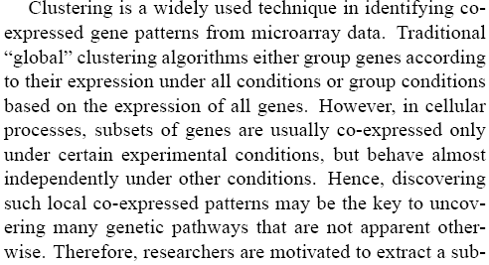
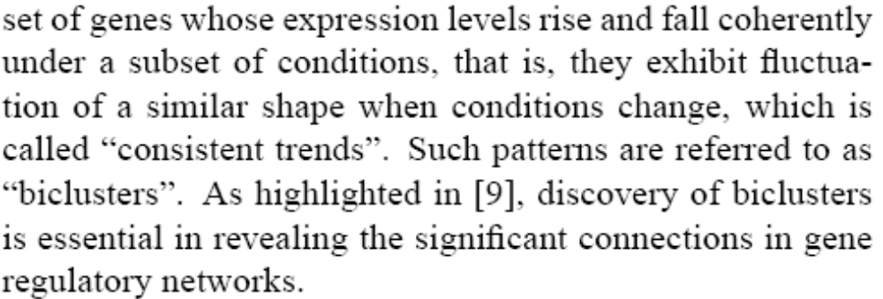
Background→Topic

Slide 6
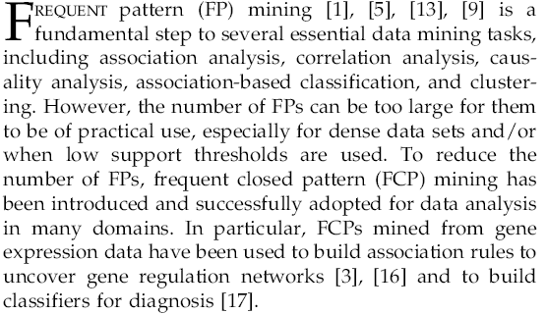
Background→Topic

Slide 7
Introduction
Background→ Topic (1-2 paragraphs)
Literature Review→ Motivation (1 paragraph)
Algorithm Overview (1 paragraph)
Contributions (1 paragraph)
Experiment Overview
Roadmap (1 paragraph)

Slide 8
Literature Review→Motivation
Notable Method Summarization (focus on
nearest neighbors)
Comments (weakness)
Motivation (against the weakness)

Slide 9
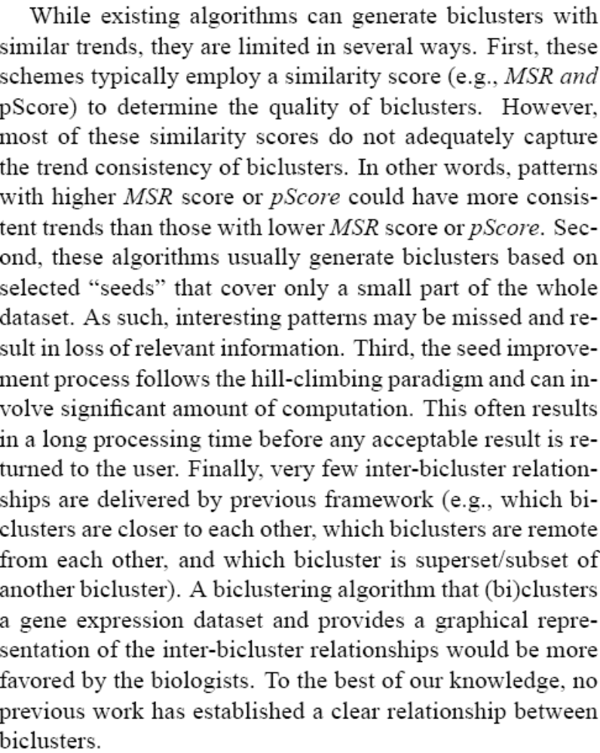

Slide 10
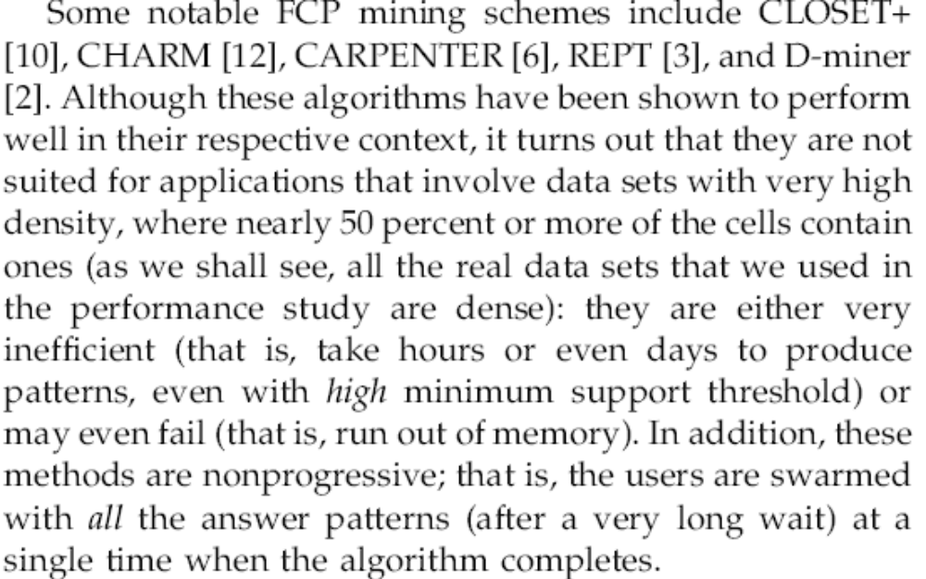
Literature Review→Motivation

Slide 11
Introduction
Background→ Topic (1-2 paragraphs)
Literature Review→ Motivation (1 paragraph)
Algorithm Overview (1 paragraph)
Contributions (1 paragraph)
Experiment Overview
Roadmap (1 paragraph)

Slide 12
Algorithm Overview & Contribution
Method Definition
Principle Description (How to make it better?)
Contribution

Slide 13
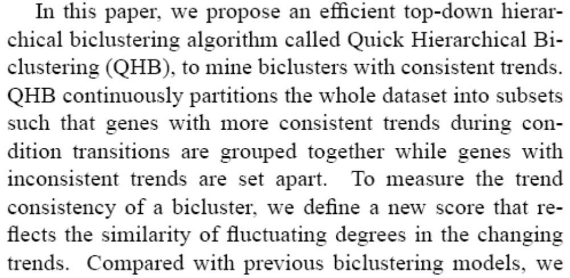
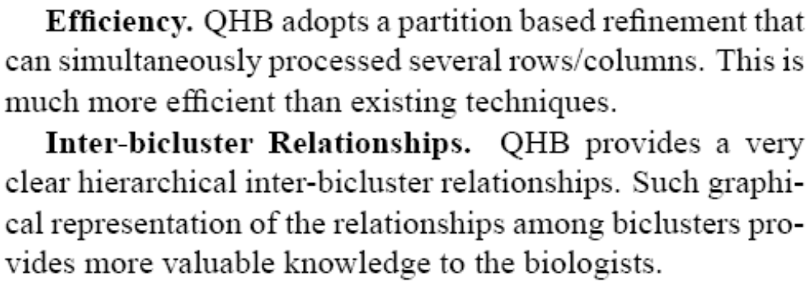
Algorithm Overview & Contribution

Slide 14
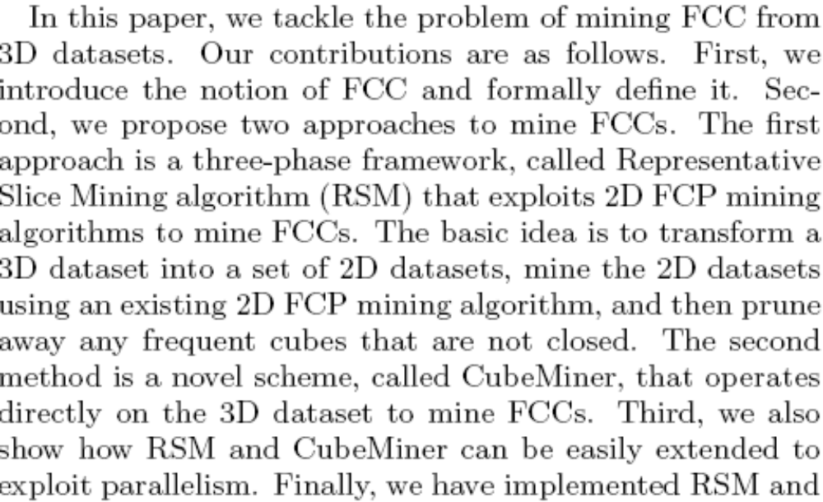

Algorithm Overview & Contribution

Slide 15
Contributions
New Concept
New Model
New Algorithm (More Efficient, Less Memory,
Parallelism and etc.)
New Result (Significant in Application Domain)

Slide 16
Introduction
Background→ Topic (1-2 paragraphs)
Literature Review→ Motivation (1 paragraph)
Algorithm Overview (1 paragraph)
Contributions (1 paragraph)
Experiment Overview
Roadmap (1 paragraph)

Slide 17
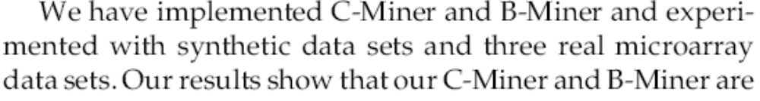
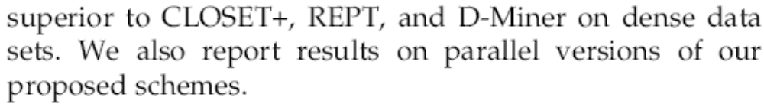
Experiment Overview
Implementation
Data
Result

Slide 18
Introduction
Background→ Topic (1-2 paragraphs)
Literature Review→ Motivation (1 paragraph)
Algorithm Overview (1 paragraph)
Contributions (1 paragraph)
Experiment Overview
Roadmap (1 paragraph)

Slide 19
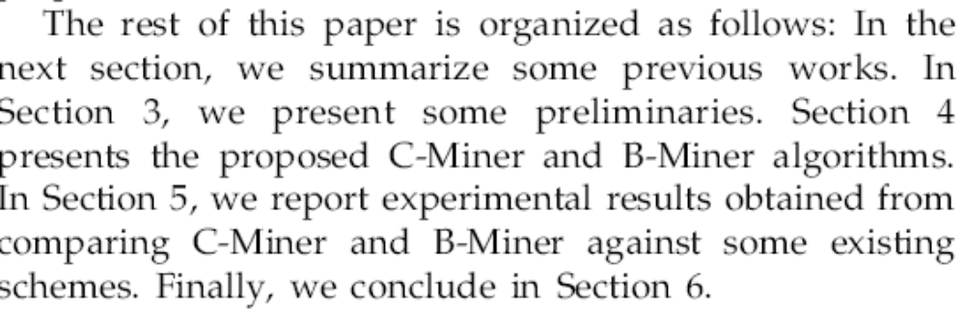
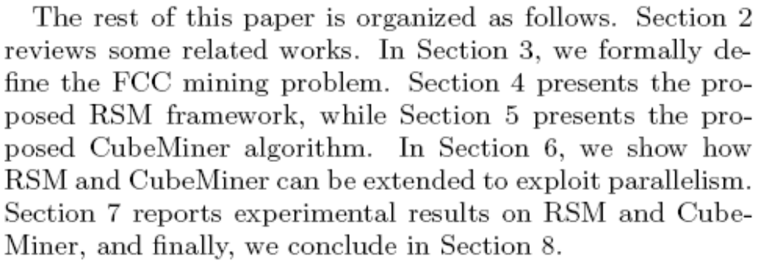
Roadmap

Slide 20
Introduction
Background→ Topic (1-2 paragraphs)
Literature Review→ Motivation (1 paragraph)
Algorithm Overview (1 paragraph)
Contributions (1 paragraph)
Experiment Overview
Roadmap (1 paragraph)

Slide 21
Five Main Sections
Abstract, Keywords
Introduction
Related Work (Literature Review)
Preliminary
Algorithm (Method)
Experimental Results
Conclusion & Future Work

Slide 22
Related Work (Main Content)
Detail some notable works
Give comments individually or by group
Summarize irrelevant works in a few words
Head and tail
In time or advancing order
Put to the bottom the methods to be compared

Slide 23
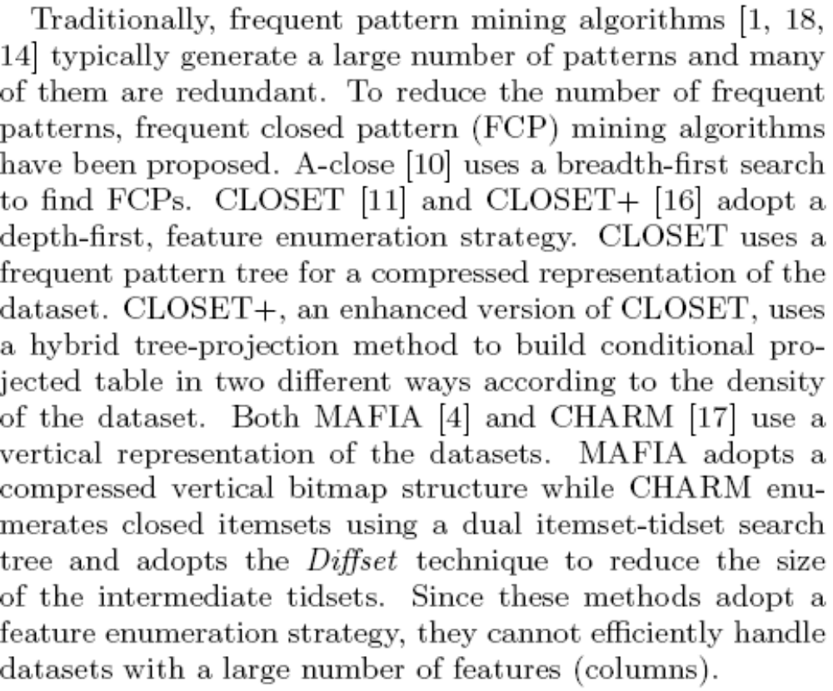

Slide 24
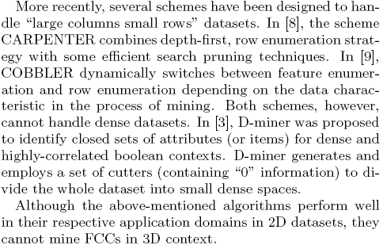

Slide 25
Related Work (Supplement)
Add the head
There are plenty of covert channel methods in literature. Here, we will only review some notable work due to space limitation.
Now (Here/ In this section), we will review some notable methods (previous work)……

Slide 26
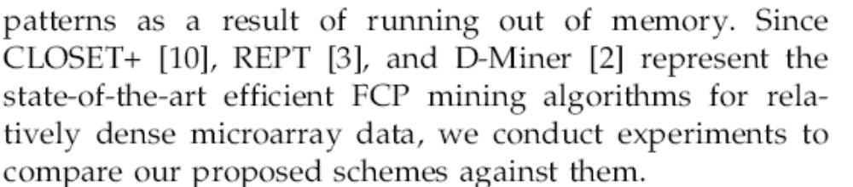
Related Work (Supplement)
Add the tail
Hence, we are motivated to……

Slide 27
Five Main Sections
Abstract, Keywords
Introduction
Related Work (Literature Review)
Preliminary
Algorithm (Method)
Experimental Results
Conclusion & Future Work

Slide 28
Preliminaries
Applying to paper with lots of definitions
Three Components:
Overview
Definitions
Problem Definition

Slide 29
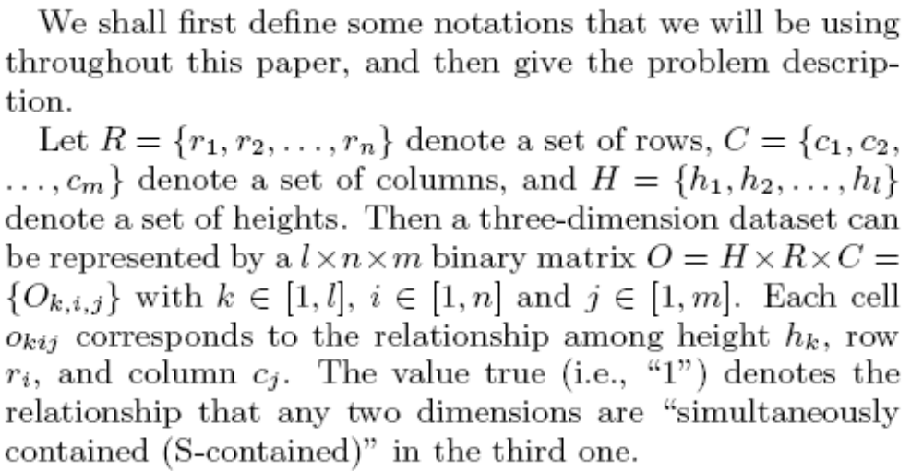
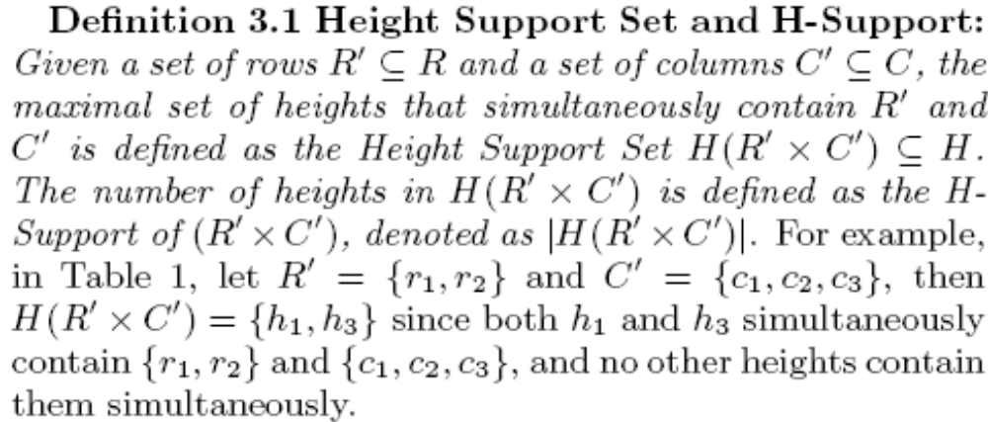
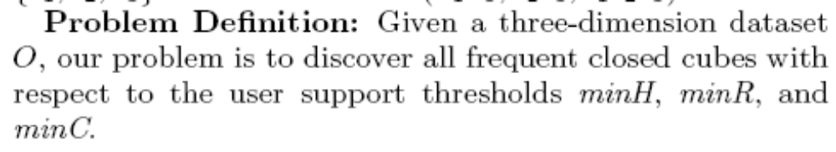

Slide 30
Five Main Sections
Abstract, Keywords
Introduction
Related Work (Literature Review)
Preliminary
Algorithm (Method)
Experimental Results
Conclusion & Future Work

Slide 31
Algorithm (Method)
Overview
Preliminaries (Definitions, Model Description)
Put the whole idea in Phases or Steps
Emphases which phase/step/part makes the
algorithm outstanding
Use running examples, figures, tables,
pseudo-code......
Supplementary (limitations, suggestions, future work…)

Slide 32
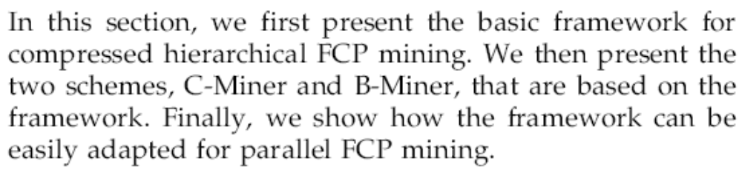
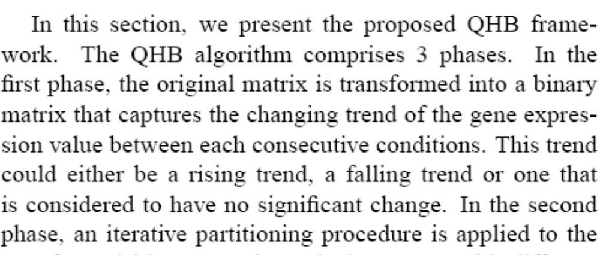
Algorithm (Overview)

Slide 33
Algorithm (Main Content)
Phase 1
Step 1
Step 2
Phase 2
In the 1st step
In the 2nd step
Phase 3
……

Slide 34
Algorithm (Try to Make it Clear)
Alice and Bob would take the following five steps to transmit the secret message:
Step 1: Alice and Bob communicate normally. They both record the message
lengths sent by Alice, and make the record as Reference.
Step 2: Alice and Bob select a length l from the Reference by the same random
algorithm.
Step 3: In the ith sending, Alice sends to Bob a message of length lnext =l+SUMi.
The Reference is updated by appending lnext.
Step 4: Bob decodes the ith message into Wi by subtracting l from lnext.
In our method, the Step 2 and 3 ensure that each sending message would
learn from the normal network traffic (Reference) so that messages from our
channel have similar length distribution as normal network messages.
To better resist the detection, our scheme could be further enhanced through
the way that Alice periodically sends to Bob redundant normal network
messages during the transmission.

Slide 35
Five Main Sections
Abstract, Keywords
Introduction
Related Work (Literature Review)
Preliminary
Algorithm (Method)
Experimental Results
Conclusion & Future Work

Slide 36
Experimental Results
Overview: tool, data, methods to compare
Data Description
Data Preprocessing
Compare against other algorithms (methods)
Parameter Studies (Optimization)

Slide 37
Experimental Results
Experimenting on the Clartnet dataset [9], we compared our scheme with Girling’s[3] and Yao’s[8] models, and estimated the upper bound of our model’s bandwidth.
4.1 Dataset
Clarknet dataset [5] contains the logs of 1.6 million HTTP queries from two weeks. We take the 7239 queries from Client ‘piweba5y.prodigy.com’ as the messages for our experiments. In each query, the average size of transmitted message is 489 bytes (39 bytes message + 450 bytes header).

Slide 38
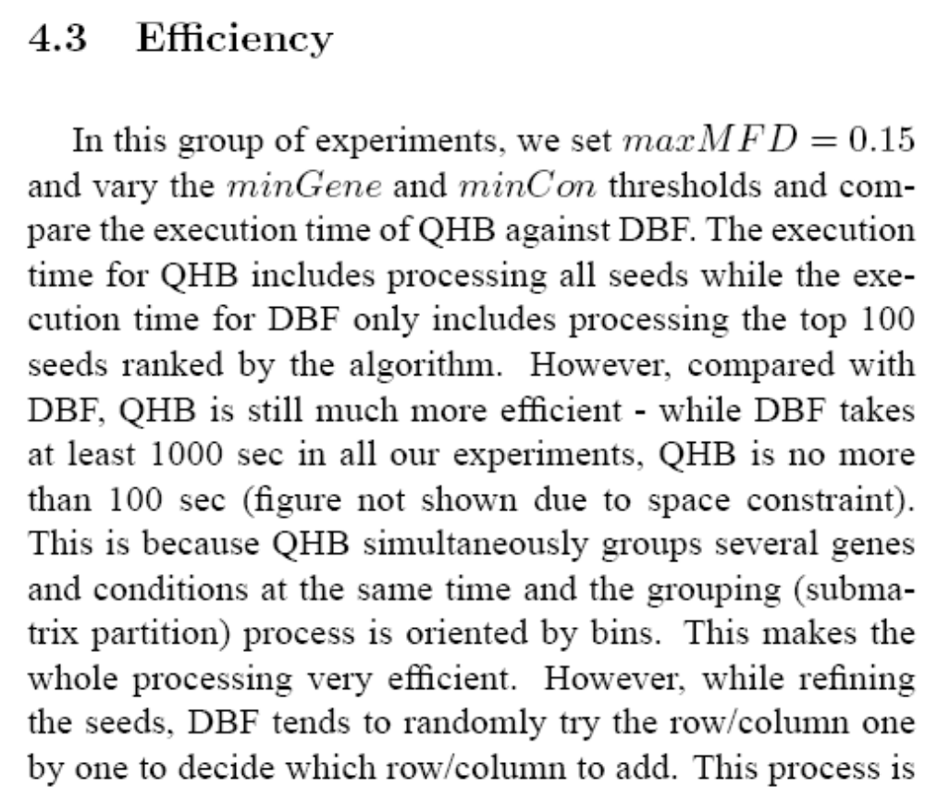
Experimental Results

Slide 39
Five Main Sections
Abstract, Keywords
Introduction
Related Work (Literature Review)
Preliminary
Algorithm (Method)
Experimental Results
Conclusion & Future Work

Slide 40
Conclusion & Future Work
Summarize what we did in the paper
Method
Experimental Results
Benefits (Application)
Future Work

Slide 41
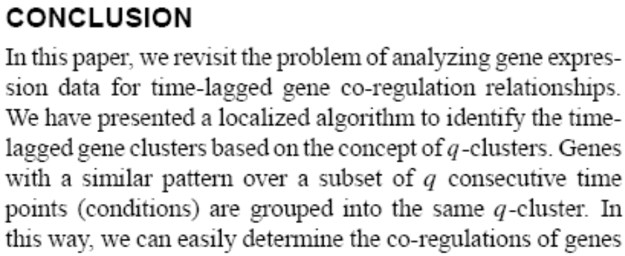
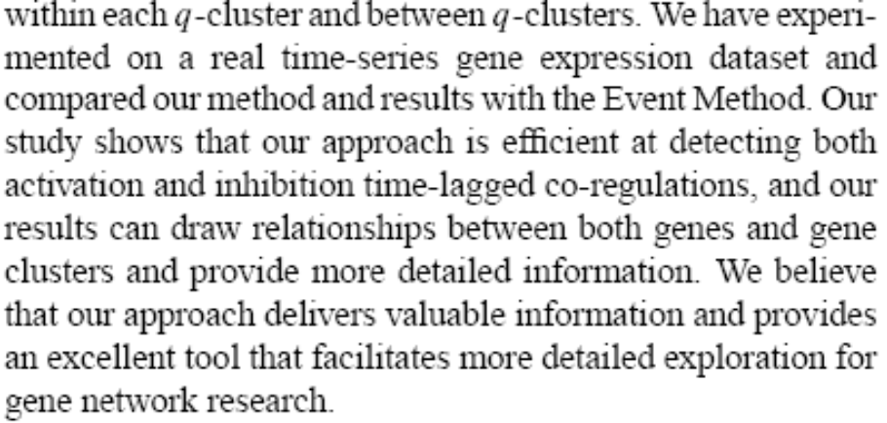
Conclusion & Future Work

Slide 42
Five Main Sections
Abstract, Keywords
Introduction
Related Work (Literature Review)
Preliminary
Algorithm (Method)
Experimental Results
Conclusion & Future Work

Slide 43
Abstract
Motivation
Topic Importance
Literature Review: However, existing work…
Method: In this paper, we….
Experimental Results
Application

Slide 44
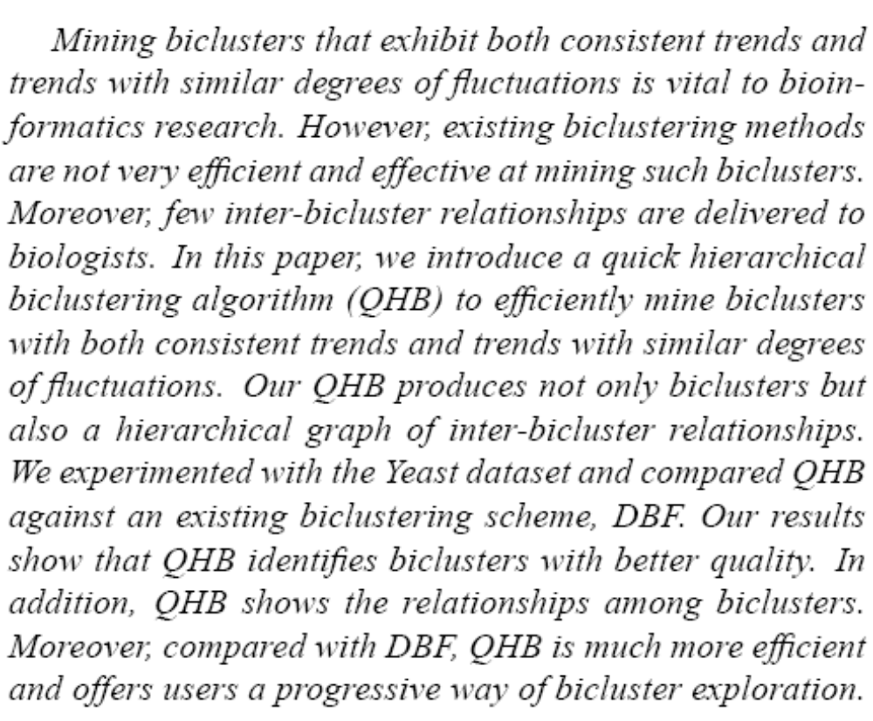
Abstract

Slide 45
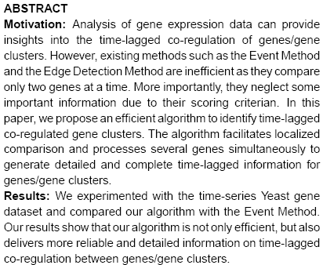
Abstract vs. Conclusion

Slide 46
Five Main Sections
Abstract, Keywords
Introduction
Related Work (Literature Review)
Preliminary
Algorithm (Method)
Experimental Results
Conclusion & Future Work

Slide 47
Presentation

Slide 48
Present Your Work Powerfully
Motivation (Make your audience interested)
Background (Application)
Literature Review (Theory)
Main Work & Contribution (Get your audience prepared)
Algorithm (Keep your audience awake)
Experimental Results (Defense yourself with facts)
Conclusion & Future Work (summary & new directions)

Slide 49
Algorithm
No Pseudo Code !
No Lemma !
No Formula !
No Long Sentence Description!
Use Figures
Use Running Examples
Explain what mechanism makes the algorithm great

Slide 50
How to Make Great Presentations?
K.I.S.S.
—Keep It Simple and Stupid !

Slide 51


Q&A
Notes:
http://chalkpaperscissors.com

